Slide 1
Eating Disorders and Autism
27th February 2021

Slide 2
Programme
What is autism?
The expression of autism in girls
Autistic pathways to an eating disorder
Adaptations to treatment to accommodate the characteristics of autism

Slide 3
What is Autism?
The Diagnostic Criteria for ASD in DSM 5: A1
Deficits in social-emotional reciprocity
Introvert: shy, withdrawn and isolated, alone not lonely
Extrovert:
1. Intense and intrusive
2. Observes, analyses and imitates

Slide 4
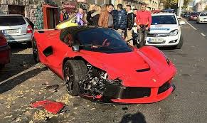
1: Intense and Intrusive: Italian Driver

Slide 5
2: Observation, Analysis and Imitation
Watching socially popular children
Searching for patterns in behavior
Becoming a child psychologist
Copying mannerisms, speech, clothing, topics of conversation

Slide 6
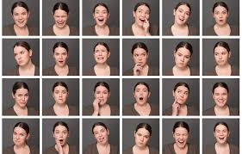
DSM 5 Diagnostic Criterion A2
Deficits in non-verbal communicative behaviours used for social interaction;
Reading facial expressions, gestures, tone of voice and social cues and context
Theory of Mind: Determining what someone is thinking, feeling and knows
Self-reflection, Theory of Internal Mind

Slide 7

Criterion A3
Deficits in developing, understanding and maintaining relationships
Making and keeping friends

Slide 8

Criterion B1 and B2:
Restricted, repetitive patterns of behaviour, interests, or activities as manifested by at least two of the following:
B1: Repetitive motor movements
Signature hand flapping, toe walking, spinning objects
B2: Insistence on sameness, inflexible adherence to routines
Aversion and resistance to change and requests
Coping with transitions
Rigid thinking
Daily routines to be maintained

Slide 9
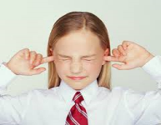

Criterion B3 and B4:
B3 Highly restricted, fixated interests that are abnormal in intensity or focus
Collecting objects then encyclopaedic information on a theme, person or animal
B4: Hyper- or hypo-reactivity to sensory input or unusual interest in sensory aspects of environment
Auditory, tactile, visual, aroma
Startle and pain reaction
Apparent indifference to pain, hunger, needing the toilet

Slide 10
Associated with Autism
ADHD
Specific learning disorders, dyslexia
Social rejection and bullying
Anxiety and depression
Emotional sensitivity
Alexithymia
Different learning style

Slide 11
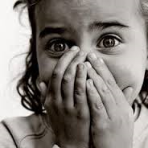
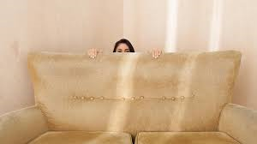
Emotional Sensitivity
Overly sensitive to another person’s negative mood
Hyper-sensitive to disappointment, anxiety or agitation

Slide 12
Empathic Attunement
There’s a kind of instant subconscious reaction to the emotional states of other people that I have understood better in myself over the years
If someone approaches me for a conversation and they are full of worry, fear or anger, I find myself suddenly in the same state of emotion
I am able to distinguish very subtle cues that others would not see, or it might be a feeling I pick up from them
A ‘sixth sense’
Avoidance of some social situations due to being sensitive to ‘negative vibes’

Slide 13
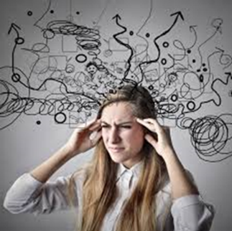
Alexithymia
A diminished vocabulary to describe the different levels of emotional experience
Especially subtle and complex emotions
“I need a language for my worries” An 8 year old boy with ASD

Slide 14
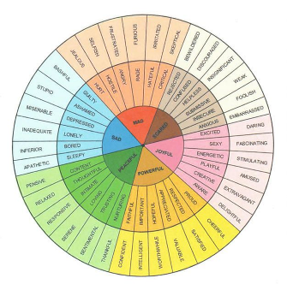
Alexithymia
“How were you feeling”
“I don’t know”
‘I don’t know how to mentally grasp the intangible negative emotions swirling in my mind, identify and label them accurately and communicate those feelings in speech so that you will understand’
Eloquent expression using music, lyrics, poetry, typing an e-mail, or art

Slide 15
Alexithymia, Autism and Eating Disorder
Vuillier, Teixeira and Moseley (2020) Molecular Autism 11:63
Toronto Alexithymia Scale and the levels of Emotional Awareness Scale, AQ, Eating Attitudes Test
Alexithymia recognized in ASD and ED
Confirmed alexithymia may mediate risk of eating psychopathology in ASD

Slide 16

Interoception: Perception of Inner Signals
Diagnostic assessment of an adult
“How did you know…….?
“I only know what I am feeling by seeing what I am doing”

Slide 17

exteroception
Sensing the outside
————
SIGHT
SOUND
TOUCH
SMELL
TASTE
interoception
Sensing the inside
————
HEADACHES
HUNGER
EMOTIONS

Slide 18

Different Learning Style
Visualizers or verbalizers
Uneven profile of abilities
Processing time
One-track mind
Compulsion for completion
Finding patterns or ‘systems’
Fear of making a mistake
Talents including art, mathematics and music

Slide 19
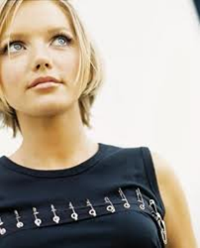
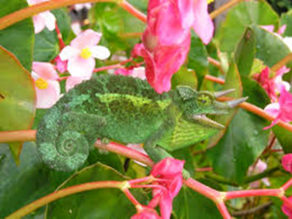
The Expression of Autism in Girls
Observation and absorption of the speech, mannerisms and character, even persona of someone who is socially successful
Over-analyzing social situations (analysis to paralysis)
Becoming a child psychologist
Reading fiction (or watching soap operas) helps learn about inner thoughts and feelings
Decode social situations in doll play and talking with imaginary friends
Chameleon

Slide 20

Camouflaging
I have done such a great job at pretending to be normal that nobody really believes I have Asperger’s
I can dance. I can dance with anyone who wants to dance with me, but it is always their choreography
For a brief while, ‘cured’ of autism
Surface sociability but a lack of social identity
Supress stress at school, released at home

Slide 21
Identify with boys
Many stereotypical girls activities were stupid, boring and inexplicable.
It is more accurate to say that I am gender-neutral. As a child I liked to play with boys because I enjoyed toy cars, Lego building blocks, sports and that kind of thing, and sadly girls are not often given toys like cars and blocks; also girls were more complicated, and unkind in ways I didn’t understand.
Boys are more logical.

Slide 22
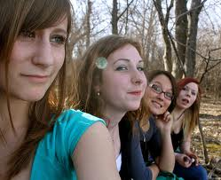
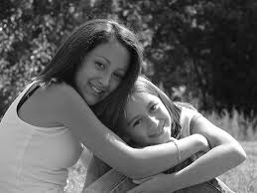
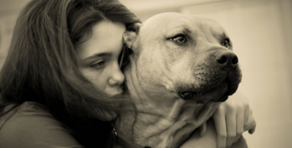
Peer support (not bitchy)
Single friend who provides guidance and security
Age irrelevant
Animals as friends

Slide 23
Social Experiences of Adolescent Girls
Groups: ‘too many opinions’ and disagreement and conflict between peers
Felt they needed to act as peacemaker when conflict arose
May be more sensitive to conflict between friends
Aware peer girls changed style of dress and interests to focus more on boys
These were not interests they shared or saw as positive
Seeking connection with a peer group

Slide 24

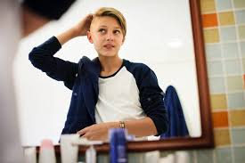

Ultra-feminine or anti-social conventions
Adolescent Autistic Girls
Try to fit in during Primary School by being ultra feminine (pink and frilly)
In adolescence, when it is not working, the pendulum can swing the other way
Despise femininity and defy social and gender conventions

Slide 25
ASD and ED Similarities
Flexible thinking
Theory of Mind
Emotional processing
Emotional literacy

Slide 26
Eating Disorders: ARFID (Selective Eating Disorder)
Persistent food restriction where nutritional needs are not met
Loss of interest in food
Concern about the consequences of eating (e.g. vomiting)
Avoidance and anxiety due to the sensory characteristics of food

Slide 27
Prevalence of Eating Disorders and ASD
Brown et al (2020) Molecular Autism
Systematic review and meta-analysis
Overall prevalence of ASD in combined ED populations ranges from 1.15% to 30.00%
Comorbidity often overlooked

Slide 28
Autistic Pathways to an Eating Disorder
Research
23% of women hospitalized for anorexia met the dx criteria for ASD (Westwood, Mandy and Tchanturia 2017)
Traits preceded the onset of the eating disorder ( Mette Benze et al 2017; Schulte-Ruther et al 2012)
Therapeutic models need to be altered
Do not fit a classical eating disorder profile
Difficulty describing/expressing their eating disorder
Those with an eating disorder and ASD have poorer outcomes (Arcelus et al 2011)

Slide 29
Motivation for an Eating Disorder and Autism
Self-perception, shape and weight (dislike who I am and how I look)
Connectedness (finding a culture of those who accept and encourage you)
To solve a problem (changes associated with puberty and sexuality)
Control in your life (Anxiety)
An Autistic rule (I am smarter when I eat less) – Autistic archeology
Family tension at the meal table (empathic attunement) and an eating disorder as a coping mechanism

Slide 30
Motivation for an Eating Disorder and Autism
Knowledge of food, calories, sugar and fat content – special interest
Becoming an expert
Social media postings of those of similar mind - connectedness
Identification and connection with vegetarians and vegans as well as food, diet and weight gurus
Acquiring rigid and restrictive rules regarding food consumption and an eating ritual and routine
Section B of the diagnostic criteria

Slide 31
Associated Concerns
Theory of Mind (decreases with decreasing BMI)
Residential treatment (culture, being away from home, sensory sensitivity, need for solitude)
Group activities and self-disclosure
Understanding of ASD by staff
Alexithymia
Group therapy (social dynamics, empathic attunement and vulnerability)
Duration of sessions (exhaustion)

Slide 32
Issues in Therapy
ASD in the family
Intense emotions and meltdowns
Difficulty achieving and delayed emotional repair
Conventional repair mechanisms not effective (talking, compassion and punishment)
‘One track ‘ mind and single-minded determination (considering alternative perceptions and responses)
Sensory sensitivity (auditory, olfactory, visual, tactile)

Slide 33
Issues in Therapy
Literal interpretation - idioms, sarcasm, jokes
Additional anxiety disorder, depression (self-harm) , ADHD, Pathological Demand Avoidance (PDA), Personality Disorder (BPD)
A detailed and comprehensive functional analysis for an Eating Disorder
Knowledge of the person’s learning style (The ASD cognitive profile)
Any signs of PTSD and bullying

Slide 34
Therapy Options for ASD Adolescents
Discovering a new culture (those who have autism, wisdom and empathy)
Energy Accounting (Stress management and to prevent relapse)
Focus on personal positive consequences, metaphors and logic rather than punishment
Sensory accommodations and desensitization around food and aroma
Developing social and friendship skills

Slide 35
Therapy Options for ASD Adolescents
Psychoeducation (emotions and eating)
Comic Strip Conversations and Social Articles
Yoga, mindfulness, meditation
Concept of self (positive concept of autism)

Slide 36
Anorexia Nervosa and ASD
Brede et al (2020) JADD 50, 4280-4296
44 semi-structured interviews of 15 autistic women, parents and healthcare professionals
Thematic analysis to identify patterns
Studies have consistently shown 20-35% of women with Anorexia Nervosa (AN) meet diagnostic criteria for autism
For many women with AN, autistic traits present in early childhood and predated AN

Slide 37
Anorexia Nervosa and ASD
Previous studies have criticized current service provision for not addressing the needs of those with ASD and AN
Those with ASD and AN have worse outcomes and lower recovery rates and rates of functioning than AN women without ASD
Eating Disorder (ED) clinicians often feel they do not have enough knowledge of ASD for those with this dual diagnosis
Autistic traits may exacerbate factors that maintain the eating disorder rather than cause the eating disorder directly

Slide 38
Anorexia Nervosa and ASD
Main Themes of direct and indirect pathways to AN identified via thematic analysis
Sensory sensitivities
Social interaction and relationships
Self and identity
Difficulties with emotions
Thinking styles
Need for control and predictability

Slide 39
Anorexia Nervosa and ASD
Sensory Sensitivities
Sensory overload in life in general and especially the treatment environment
Some women used the effect of starvation on their body to numb these sensation
Food specific sensory sensitivities related to food texture, taste, smell, temperature and mixing different foods limits the range of food tolerance
Motivation for food restriction often related to the sensory properties rather than primarily based on calorie or fat content

Slide 40
Anorexia Nervosa and ASD
Food sensory sensitivity present since early childhood
Hypersensitivity to sensory stimuli also applied to internal sensation
Interoception
Internal sensations associated with eating such as feeling bloated, or the sensation of digesting food were perceived as very distressing
Restricting eating to avoid these sensations

Slide 41
Anorexia Nervosa and ASD
In contrast, some women talked about hyposensitivity to internal sensations
Difficulty interpreting feelings of hunger and satiety
Missing meals because they failed to notice they were hungry
Not being able to regulate an eating routine without relying on external cues
They don’t experience hunger in quite the same way

Slide 42
Anorexia Nervosa and ASD
Social Interaction and Relationships
All ASD and AN participants talked about difficulties in friendships and experiencing loneliness, bullying and abuse which affected their eating
Restricting eating described as a way to cope with social difficulties and distract from or numb consequent emotions [thought blocker]
I think I was lonely a lot… and I could get engrossed in food and exercise and just forget about everything else
Avoidance of social settings that involve food due to being overwhelmed by the social and sensory environment, did not have anyone to sit with and to avoid bullies

Slide 43
Anorexia Nervosa and ASD
Self and Identity
Almost all participants talked about lacking a sense of self, feeling different and not fitting in as central to the development of their ED
These feelings caused emotional upset and tried to cope with immersing themselves with eating disorder behaviours
Some women described dieting or focusing on their appearance as a way to fit in with peers – or provide a sense of identity
A few women concluded that the reason they did not fit in socially must relate to their body and appearance - imitation

Slide 44
Anorexia Nervosa and ASD
Societal messages about women being thin resulted in wanting to change body weight and shape in order to fit in and connect with peers
Going into hospital and being aware that everybody has the same condition, you then do become a lot more aware of some of the anorexia traits and you do sort of take them on – copying peers
Copying others and adopting their anorexic values as a way of camouflaging [connection]
Most stressed that weight loss was not the initial aim of their ED behaviour but a secondary and unintentional consequence

Slide 45
Anorexia Nervosa and ASD
What I wanted was to be able to restrict food and over-exercise without losing weight. So that’s why it was so atypical. It was more like behaviours that I engaged with to feel calm, but would lead to catastrophic weight loss – anxiety management
Assumptions by others that body image issues drove their ED behaviours made these women feel even more misunderstood and alienated
Health care professionals noted that many autistic women seemed less drawn to comparing their appearance to others or taking pride in their weight loss
Less competitive behaviours in inpatient settings

Slide 46
Anorexia Nervosa and ASD
Emotional Difficulties
Autistic women with AN may use restriction and other ED behaviours, such as exercise, in order to numb or distract themselves from overwhelming and confusing emotions
Discovered accidentally then used purposefully
When I was restricting my eating, I would get this feeling of just calmness and I know that I am safer, I know that I am not going to experience these meltdowns that made me feel embarrassed or frightened

Slide 47
Anorexia Nervosa and ASD
A healthcare professional:
Their ED is a way of channeling anxiety. They can just worry about food and nothing else and that feels more manageable than everything in their life that feels horrendous
An ASD woman with AN
I misinterpret emotions as physical symptoms and I get very anxious about it: Am I unwell? Am I going to vomit? And that’s when I stop eating because I know that will dampen things down and calm them…
Giving up their ED behaviours, but lacking alternative ways of coping was one of the greatest challenges in recovery

Slide 48
Anorexia Nervosa and ASD
Thinking styles
Black and white thinking
If I’m not thin, then I’m fat and horrible with nothing in between
Literal thinking
Overheard comments, public health advice lessons at school about healthy eating initially giving rise to rigid rules about eating and exercise leading to the development of ED

Slide 49
Anorexia Nervosa and ASD
Intense interests
Such as exercise, nutrition, veganism or environmental concerns
Passion for counting and monitoring numbers such as counting calories or looking for patterns in the numbers on weighing scales
An important source of enjoyment and achievement
To alleviate anxiety and bring calmness which contributed to their persistence
Rigid thinking
Once she’s made her up her mind about something, it is very difficult to change it.

Slide 50
Anorexia Nervosa and ASD
Need for control and predictability
Puberty and hormonal changes resulting in emotional extremes further exaggerated feelings of confusion and perceived loss of control
Stressful life events with unpredictable outcomes such as illness, conflict in the family, transitions to a new school or university leading to worsening of eating behaviours
Being able to take control of something, having clear rules to follow and creating predictability were powerful functions of AN

Slide 51
Anorexia Nervosa and ASD
Outcomes of Anorexia from an ASD perspective
Numbing down/resolving sensory and emotional experiences
Introducing calmness through control and predictability
Standard treatments for Eating Disorders need to address autism-specific mechanisms underlying Anorexia Nervosa

Slide 52

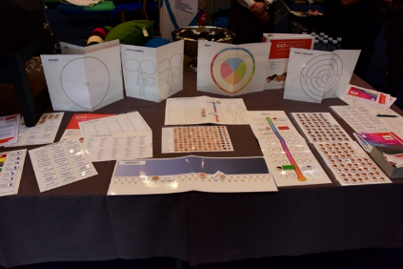
Adaptations to treatment to accommodate the characteristics of autism
Increase time spent on affective education and anxiety management
Increase body awareness (sensory processing, proprioception, interoception)
Incorporate mindful movement practice - Yoga
The CAT-kit
www.youtube.com
www.jkp.com

Slide 53
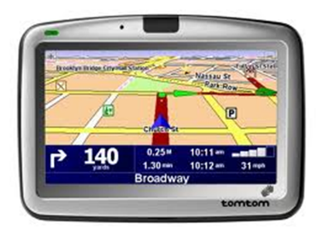
Coping with a Meltdown : Externalising
Explosion or melt-down
To cleanse the system or clear the air
“It’s a bit like wanting to vomit and knowing you will feel ill until you actually throw up. You get it over and done with and feel better. Getting it out of your system”

Slide 54
Plan for a Meltdown
Stay calm and reassuring
Not ask what is causing the distress (no interrogation)
Not move in too close without prior approval
Adolescent not listening to or considering consequences
Sanctuary for safe recovery

Slide 55
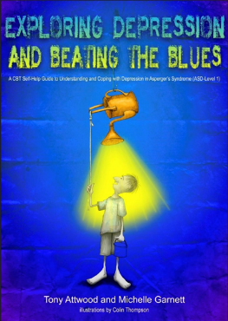
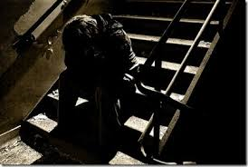
‘Depression Attack’
Arrive unexpectedly and are extremely intense
An emotional ‘implosion’
A desperate need to end the despair
Can be intense and dangerous but fortunately brief

Slide 56
Therapy Options
Discovering a new culture (those who have autism)
Energy Accounting (Stress management and to prevent relapse)
Focus on personal positive consequences, metaphors and logic rather than punishment
Sensory accommodations and desensitization around food and aroma
Developing social and friendship skills
Developing a positive sense of self

Slide 57
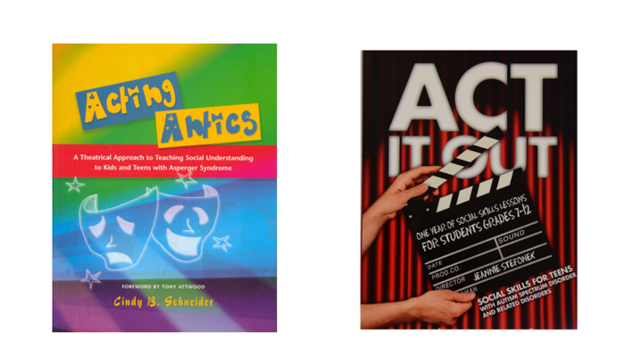
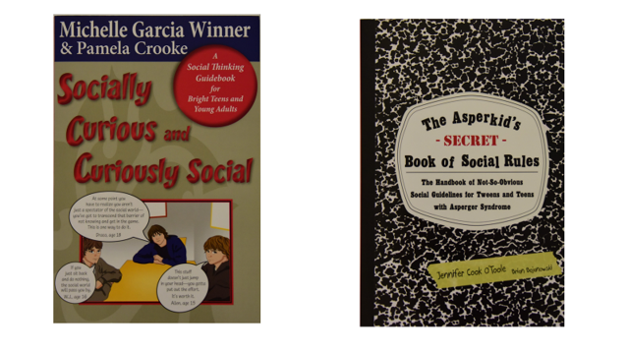
Improve Social Skills and Connectedness

Slide 58
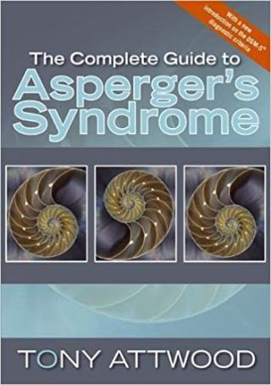
Further Information on Autism
Autism Webinars with Tony and Dr Michelle Garnett
Girls and women with ASD
Autistic Teenagers
Emotion management
Exploring depression
www.attwoodandgarnettevents.com

